Slide 1
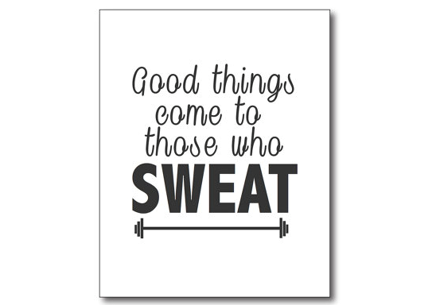
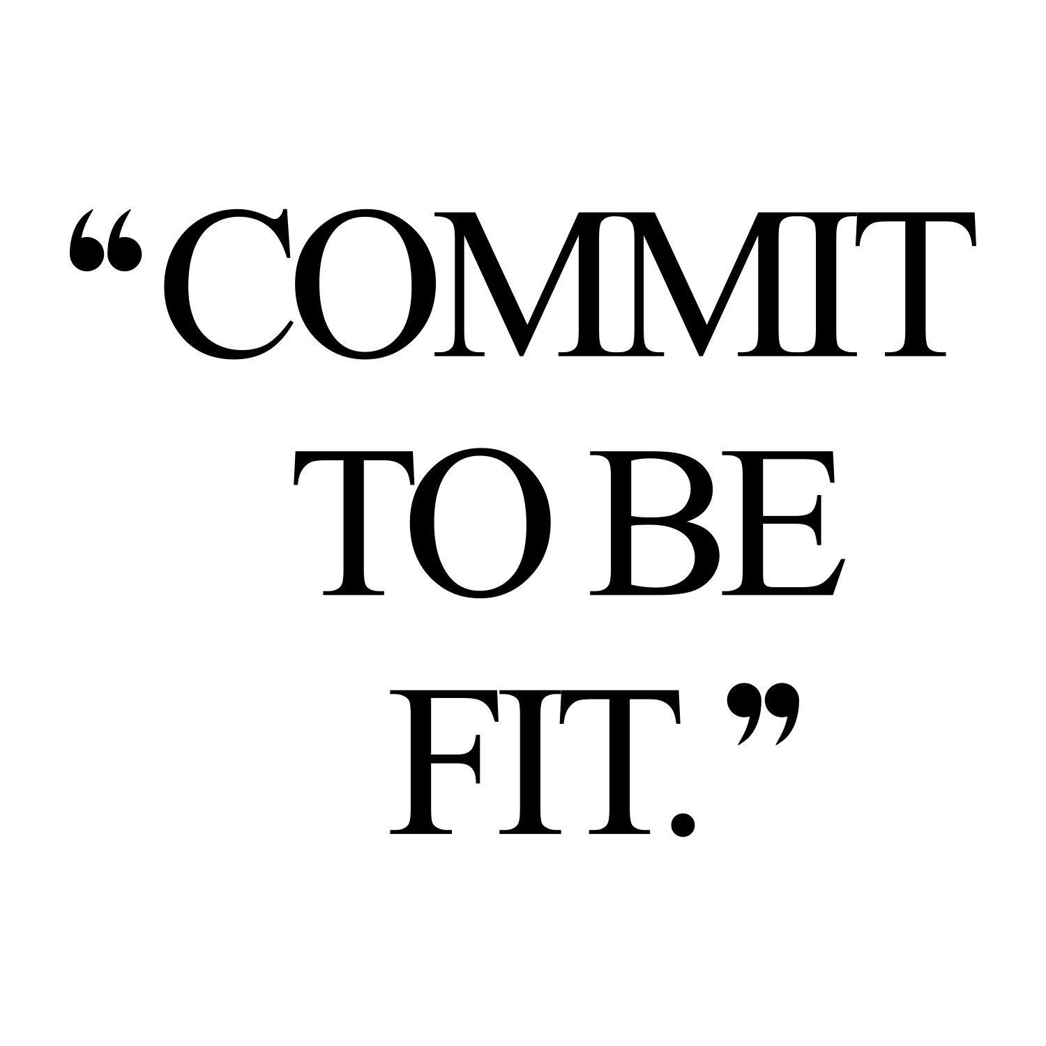
Personal Fitness
Lesson 7- The Importance of Living a Healthy Lifestyle

Slide 2
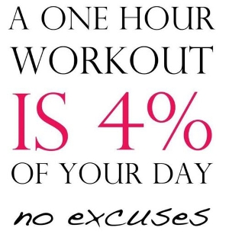
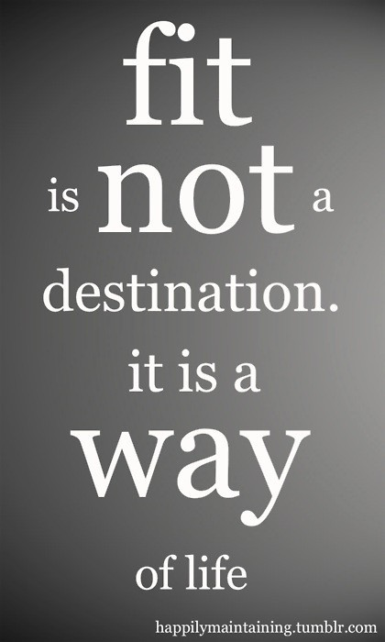
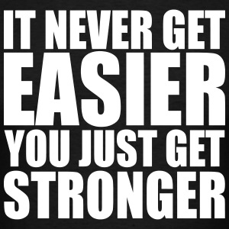
We have all been told it’s good to be physically fit, but here are the real benefits associated with being active.

Slide 3
Metabolic Health
People who are physically fit tend to suffer less from metabolic issues like Type 2 diabetes and metabolic syndrome. If a person has metabolic syndrome, she has some or all of these problems; high blood sugar, high blood pressure, high triglycerides, excess belly fat and low high-density lipoprotein ("good" cholesterol). The more exercise a person does regularly, the less chance she has of developing these health problems.

Slide 4
Cancer Risk
The Harvard School of Public Health says that fit people potentially have a lower risk of developing certain cancers. These include colon cancer in both men and women and breast cancer in women, and research indicates that endometrial cancer in women and lung cancer in both sexes may possibly also be positively influenced by staying fit.

Slide 5
Bone Strength
Osteoporosis is a condition where bones become more fragile and fractures are more likely. This is associated with aging, but the Harvard School of Public Health says that staying fit helps lower the risk of this happening. Examples of useful activities include brisk walks, dancing and weight training. These are weight-bearing exercises that force the muscle to pull on the bone, thereby influencing the bones to become stronger to handle the stress. Keeping bones strong also helps reduce the risk of fractures.

Slide 6
Mental Health
Keeping physically fit does not just influence the physical body. The Harvard School of Public Health says regular exercise boosts mood and can potentially help reduce depression. People who are fit may also have less trouble sleeping, and if you stay fit as you age, you can also potentially help prevent a decline in cognitive abilities.

Slide 7
Longevity
The CDC says that keeping fit is one of the most important things you can do to increase your longevity. People who are active for about 7 hours a week, the CDC says, have about 40 percent less chance of dying early than those who are more sedentary. In addition, fit older people are generally less likely to suffer falls or have issues affecting everyday movement and activities than those who are less fit.

Slide 8
Major boost in self-confidence and self-esteem
Look good, feel good. People who are fit tend to feel good about themselves. They are proud of their hard work and are more likely to take healthy risks in life and put themselves out there.

Slide 9
What does it mean to plateau in training?
When applied to an exercise program, the term “plateau” refers to a period of time in which your body no longer responds to your fitness or diet routine. This can manifest itself in both strength and cardiovascular training, as well is in weight loss.

Slide 10
What to do if you hit a plateau while strength training
Consider switching things up
Modify your sets and reps
Change up the tempo of your exercises
Experiment with different exercises
Experiment with variable resistance (such as bands or chains)
Take time off and restart
Make sure you are getting enough sleep

Slide 11
What to do if you hit a plateau in your weight loss program
Reevaluate your caloric needs (could it be that you now need less because you have lost some weight?)
Eat more healthy fats
Increase the amount of protein you consume
Drink more water

Slide 12
Proven ways to stick with your fitness plan
Set realistic goals
Take baby steps and celebrate even the smallest gains
Look at your fitness plan as a never ending life experiment that will be changed and altered many times
Don’t allow yourself to get bored- mix it up by challenging yourself
Make exercise social
Track your progress

Slide 13
And last, but not least, make fitness personal
What are you trying to achieve?
What do you want to get out of being physically active?
What motivates you?
What makes you feel good about yourself?

Slide 14
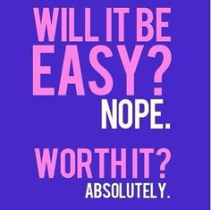
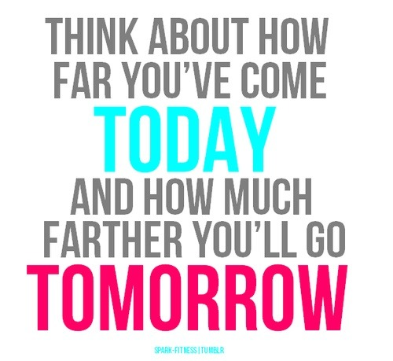
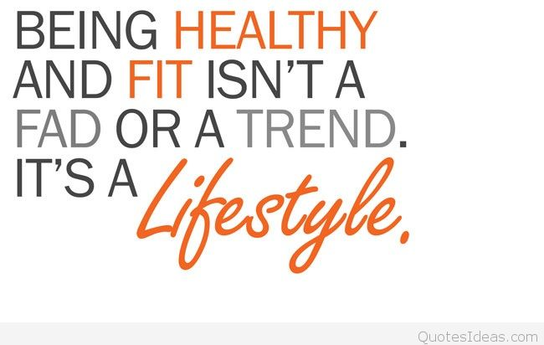
FITNESS IS NOT ONE SIZE FITS ALL. DECIDE WHAT WORKS FOR YOU AND MAKE IT A PART OF YOUR DAILY LIFE.

